Slide 1


AI-Generated Real-Time Sports Commentary in Multiple Languages
AI Sports Voice

Slide 2

Contents:
01
Team Members
05
Detailed Flow of AI-Generated Real-Time Sports Commentary in Multiple Languages
02
Project Overview
06
Best AI Model for Implementing AI-Generated Real-Time Sports Commentary in Multiple Languages
03
Problem Address
07
Project Phases and Budget Allocation
04
Project Timeline
08
Summary

Slide 3

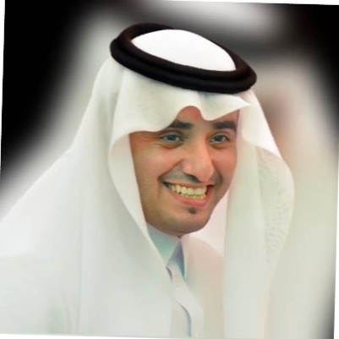
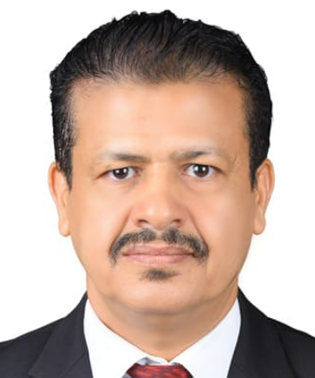
Team Members
Muhammad Noman Saeed
Turki Mesfer Alqahtani
Khaled Mohammed Noaman
Supervisor Name - Sadeem alqassem

Slide 4
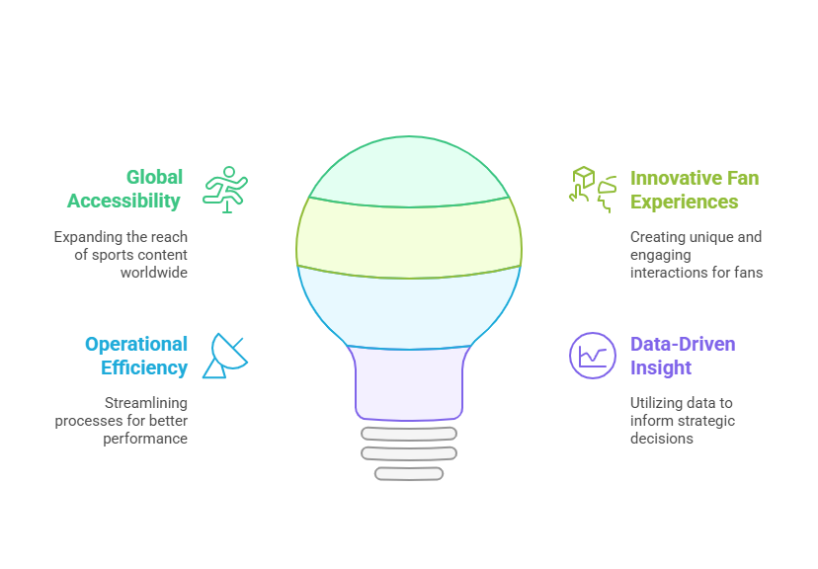
Project Overview
The AI League’s strategy focuses on leveraging AI technologies to enhance fan experiences, expand global reach, and drive innovation in sports broadcasting. The AI-generated real-time sports commentary aligns seamlessly with this vision by:

Slide 5
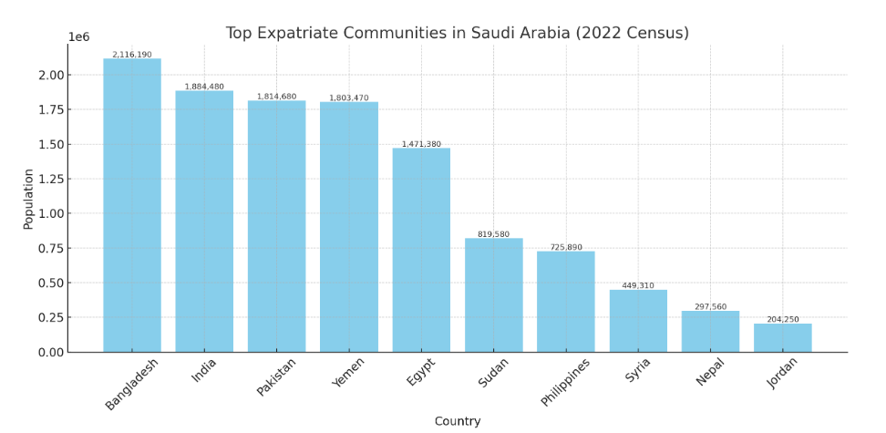
Project Overview
According to the 2022 Saudi Arabian census, there are approximately 13.4 million foreign residents in Saudi Arabia, making up 41.6% of the total population of 32.2 million.
This concept is a strong fit for Saudi Arabia’s vision for the 2034 FIFA World Cup, offering a scalable approach to attract new fans, enhance engagement, and streamline broadcasting processes.

Slide 6
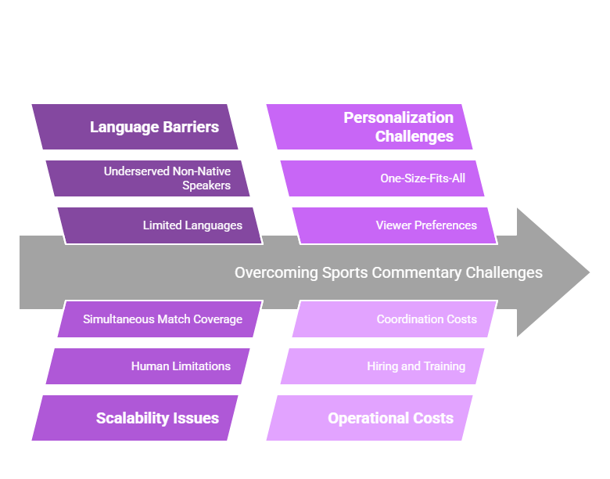
Problem Address

Slide 7
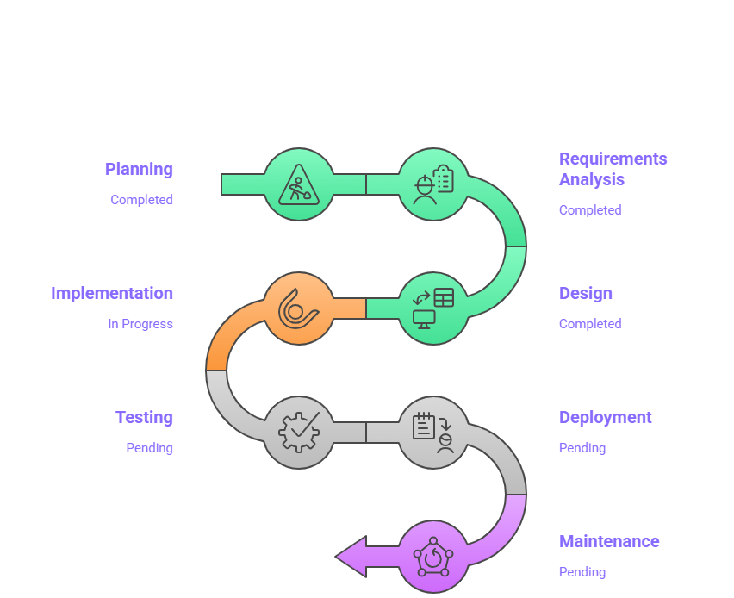
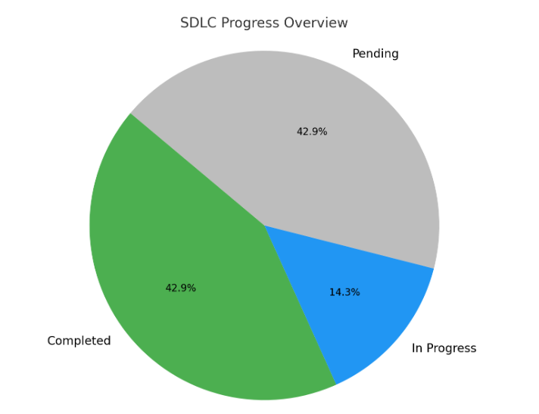
Project Timeline
(SDLC)

Slide 8
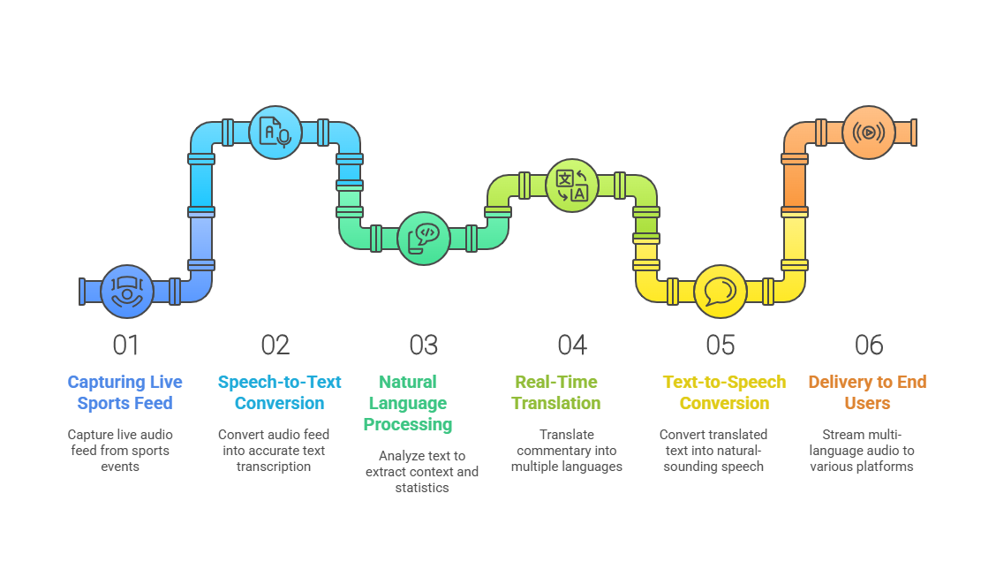
Detailed Flow of AI-Generated Real-Time Sports Commentary in Multiple Languages

Slide 9
Summary of Detailed Flow
Stage | Input Example | Output Example
Speech Input Capture | Live commentary: “Goal by Messi!” | High-quality audio format
Speech-to-Text (STT) | Audio feed | “Goal by Messi!” (text)
NLP and Context Analysis | Transcribed text | “Messi scores his 25th goal this season!”
Translation (Multilingual) | English text | Spanish: “¡Gol de Messi!”
Text-to-Speech (TTS) | Translated text | Natural-sounding audio in Spanish
Delivery and Personalization | Language preference: Spanish | Live, personalized audio commentary in Spanish

Slide 10
AI Model Combination for Implementing Real-Time Sports Commentary in Multiple Languages
Models | Purpose | Best Model | Role
Natural Language Processing (NLP) Models | Understanding match context, extracting key information, and generating accurate and engaging commentary | Hugging Face Transformers (BERT & GPT-2) | Context-aware commentary generation and understanding match dynamics
 |  | sPACy | Named Entity Recognition (NER) to identify players, teams, locations, and events during the match.
Generative AI Models | Real-time generation of engaging, context-aware, and tone-specific commentary. | OpenAI GPT 3.5 / GPT-4 | Generates dynamic and personalized commentary with different tones (casual, analyst, fan-favorite).
 |  | T5 (Text-to-Text Transfer Transformer) | Suitable for paraphrasing and summarizing complex match events quickly.
Real-Time Translation Models | Translate commentary into multiple languages with native-level fluency and cultural relevance. | MarianMT (Hugging Face) | Supports 40+ languages with high accuracy and low latency
 |  | Google Translate API (Free Tier) | Provides broad language support and real-time API access.
Text-to-Speech (TTS) Models | Convert text-based commentary into natural, human-like speech. | Google Text-to-Speech API | Provides real-time, human-like voice synthesis.
 |  | Amazon Polly | Converts commentary into speech with emotional inflection and multiple voice options.
Speech-to-Text (STT) Models | Transcribe live game feeds to text for real-time analysis and commentary generation | Google Speech-to-Text API | Converts live audio feeds into text with high accuracy.
 |  | DeepSpeech (Mozilla) | Open-source STT with high accuracy for sports-specific terms.
Emotion and Sentiment Analysis Models | Adjust tone and excitement levels based on crowd reactions and match events | BERT (Emotion Detection Fine-Tuned) | Detects sentiments and emotional cues in fan reactions and adjusts commentary tone accordingly.
 |  | Affectiva (Emotion AI) | Analyzes facial expressions and vocal tones from live audience feeds to gauge excitement

Slide 11
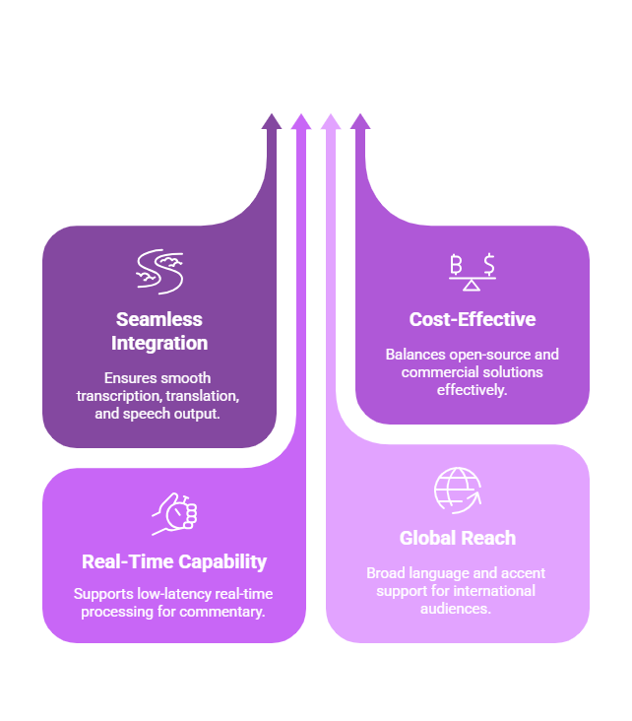
This combination offers a robust, scalable, and cost-effective solution for implementing the AI-generated real-time sports commentary system, ensuring high engagement, accessibility, and operational efficiency.

Slide 12
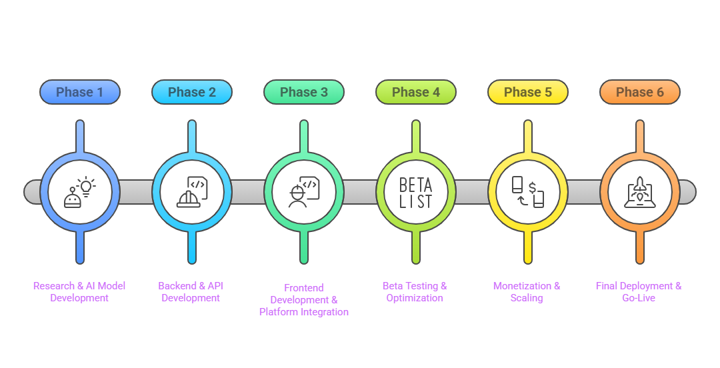
Project Phases

Slide 13
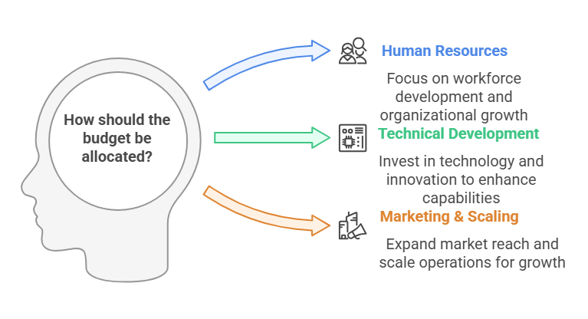
Budget Allocation
Role | Total Duration
AI Engineers (4) | 18 months
Software Developers (4) | 18 months
Data Scientists (2) | 18 months
DevOps Engineers (2) | 12 months
QA Engineers (2) | 6 months
Project Manager (1) | 18 months
UI/UX Designers (2) | 12 months
Marketing Team (3) | 6 months
Technical Resource
Cloud Infrastructure (AWS/Google Cloud)
AI Model Training (GPU Clusters)
API & Streaming Platform Integration
DevOps & Deployment Tools
Testing & QA Environments

Slide 14
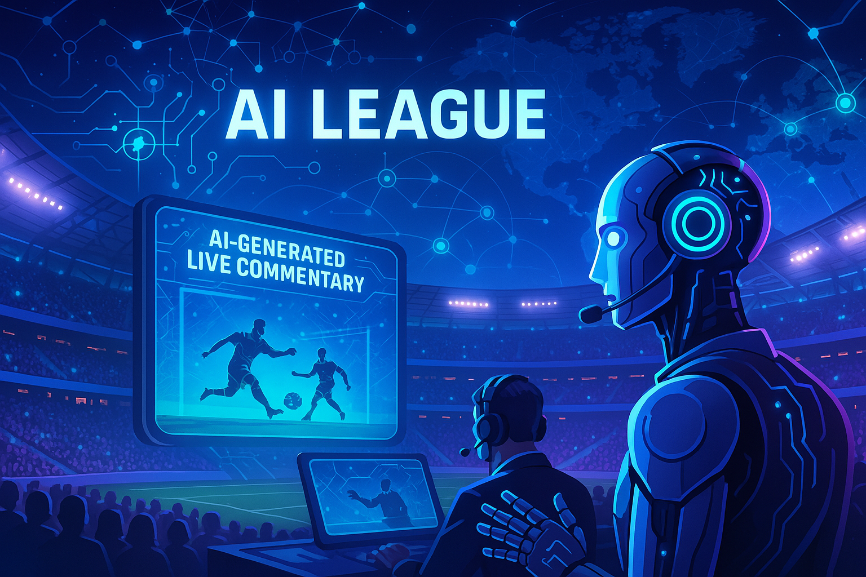
Summary
AI-powered real-time multilingual sports commentary will democratize sports broadcasting, allowing fans worldwide to enjoy localized and personalized match experiences. This technology reduces production costs, increases fan engagement, and opens new monetization opportunities for broadcasters and sports leagues.

Slide 15
Thank You

